Slide 1

Secondary Market
-
How to Buy & Sell Shares in Stock Exchange?

Slide 2

DISCLAIMER
The information contained in this material is for only educational and awareness purposes related to securities market and shall be used for non-profitable educational and awareness activities for general public.
No part of this material can be reproduced or copied in any form or by any means or reproduced on any disc, tape, perforate media or other information storage device, etc. without acknowledging the SEBI or Stock Exchanges or Depositories.
SEBI or Stock Exchanges or Depositories shall not be responsible for any damage or loss to any one of any manner, from use of this material.
Every effort has been made to avoid errors or omissions in this material. For recent market developments and initiatives, readers are requested to refer to recent laws, guidelines, directives framed thereunder and other relevant documents, as being declared from time to time. For any suggestions or feedback, you may send the same to visitsebi@sebi.gov.in.
2

Slide 3
Flow of Presentation
Pre-Trade Preparation
How to Place Orders?
Post Trade Checks
Margin Payment and Pledge/ Re-Pledge of Securities
3

Slide 4
Pre – Trade
Preparation
4

Slide 5
Why is Pre-Trade Due Diligence needed ?
Investment without analysis is like driving on a highway blindfolded.
Pro active approach enabling investors to know about the prospective investment.
Better understanding about the past performance and secure future growth of the investment
5

Slide 6
Due Diligence to be done
Underlying factors that affect a company’s actual business and its future prospects.
Questions to ask before investing include -
  Is the company’s revenue increasing?
  Is the company actually making a profit?
  Is the company able to repay it’s debts?
  Is the company in a position strong enough to compete with its peers?
6

Slide 7
Due Diligence to be done
Stock Exchange Website
Company Website
Industry Research
Newspapers/ Magazines
Social Media
7

Slide 8
How to do Due Diligence?
Review:
Data related to current economic environment affecting company’s growth and stock price.
Company’s financial health : examining cash flow statement, income statement and balance sheet for at least past 2 years.
Latest price and volume, historical data, corporate announcement, etc.
P/E ratio and intrinsic value of the share
Understand:
- Business model of the company with respect to future growth
Compare:
- Target Company and its competitors to understand the worth of the Target Company.
8

Slide 9
Important factors and metrics for Due Diligence
Reputation of Promoters & Shareholding / pledged shares of the Company.
Scope/Growth/Competition/Profitability/Structure of Industry of the Company.
Financials of the Company viz. Earnings per Share (EPS), Price to Earnings Ratio (P/E), Book Value, etc.
Cash Flows from operations.
Past Growth track record of sales turnover & profitability.
Dividends paid by company in last 5 years.
Debt of the Company.
Corporate Governance Track record.
9

Slide 10
How to Place Orders?
10

Slide 11
Place Order: Modes
Visit to broker’s Office.
Trade via Phone Call.
Through an email to Stock Broker.
By using Stock broker’s website / app on mobile (Online).
11

Slide 12
Place Order : Visit to Broker’s Office (1/2)
Check whether the Stock Broker Offers facility to trading by visit to Stock Broker’s Office.
Need to select Offline Mode of trading in the Account Opening Form.
On opening a new Account, Stock brokers provide a Welcome Kit to every new investor.
Contents of Welcome Kit :
  UCC (Unique Client code).
  Dealing office address.
  Designated Email id and phone number of Stock broker.
  Timings for placing orders.
  Brokerage / Service Charges (For online & offline trades).
  Details of Relationship Manager (if any).
12

Slide 13
Place Order : Visit to Broker’s Office (2/2)
Steps for Trading by visit to Stock Broker’s Office
Visit the Designated Branch of the Stock broker and make an entry in the visitor’s register at the premises of the Stock Broker.
Get quote for the scrip you want to trade on.
Mention scrip, price, quantity, type of order you want to place, the exchange on which you want to execute, while placing order to the Stock broker.
Provide proof of placement of order to the Trading Member.
Verify trades at the end of the trading session.
Trades are subject to payment of Margins (Explained in later slides).
13

Slide 14
Place Order : By Phone “Call & Trade”
Check whether Stock Broker offers facility to trade via Phone Call. All phone calls for placing orders with dealers are recorded.
Steps for Trading by Phone Call
Call the phone number given by the Stock Broker for placing of Orders from the Mobile number registered with the Stock broker
Call should connect to the “Call & Trade” facility desk of the Stock Broker
Confirm identity details – Name, Date of birth, PAN number etc
Place your Order – Scrip details, Quantity, Type of order etc
Trading account will be updated on successful execution of the order.
Trades are subject to payment of Margins (Explained in later slides)
14

Slide 15
Place Order : By Email
Check whether Stock Broker offers facility to trade via Email. All phone calls for placing orders with dealers are recorded.
Steps for Trading by Email
Select “Email based trading” in the Account Opening Form.
Send Email with details of trade – name of scrip, Price, Order Type, Quantity, etc.
Email must be sent from the same email ID as provided in the KYC form
Trades are subject to payment of Margins (Explained in later slides)
15

Slide 16
Place Order : Online (Website/ App)
Steps for Trading Online
Link your Trading, Demat and Bank Account.
Sign the IBT (Internet based trading) agreement after checking the costs involved and the facilities provided.
Visit website of the Stockbroker / Install the Online Trading app.
Investor must login using Username and Password provided.
Some Stock Brokers also have 2-Factor verification system where additional OTP also needs to be entered.
Check current price and volume details of stock you want to buy/ sell on Market Watch Section of the Stock broker’s terminal.
16

Slide 17
Place Order : Online (Website/ App)
Market Watch Section :
  Allows investor to check details of the stock that he wants to buy/ sell.
  Information Displayed in Market Watch:
  Last Traded Price (LTP).
  Percentage change – % Change from previous day close.
  Previous day close – At what price did the stock closed the previous day.
  O.H.L.C – Open, High, Low and Close Prices.
  Volumes – How many shares are being traded at a particular point of time?
  Bid and ask price ladder.
17

Slide 18
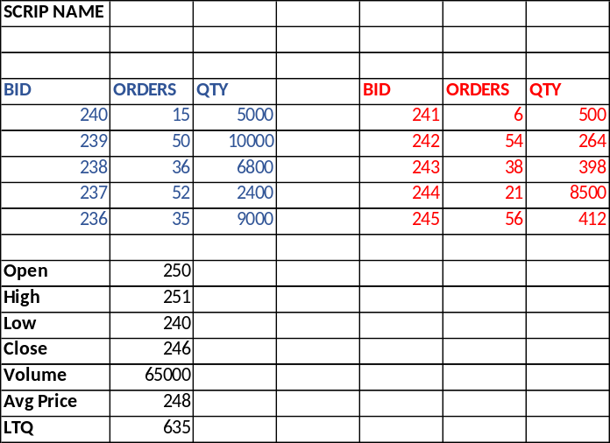
Place Order : Online (Website / App)
Always check the Orders available for the shares of the scrip before placing your order.
This gives idea of supply and demand (what quantity available for what price) of the shares.
Select the stock you want to trade in.
Place the order for Buy / Sell for a specified quantity and a specified price
Sample Order Availability Screen
18

Slide 19
Place Order : Stock Quote
Stock Quote:
  Contains data points about stock of a company.
  Valuable tool to get a brief snapshot of a company.
Details in a Stock Quote
Company name and symbol
Stock Price
High / Low
Close Price
52 week High / Low
Net Change
PE Ratio
Dividend Details
Volume
19

Slide 20
Place Order : Types of Orders
PRODUCT CODES
MIS – Margin Intraday Square-off | For Intraday training. Investor needs to pay margin uner intraday framework to use leverage provided by Stock Broker. Positions automatically squared off at EOD.
CNC – Cash and Carry | For delivery based trades. No leverage. Investor must have stock in his Demat account for selling. Positions not automatically squared off at EOD.
NRML – Normal (For F&O Trading) | For overnight trading of futures and options. Investor needs to pay margin under overnight framework to use leverage provided by Stock Broker. Positions not automatically squared off at EOD.
20

Slide 21
Place Order : Types of Orders
ORDER TYPE
Limit (L) | Buy only if price falls to certain level.
Market (Mkt) | Buy/Sell at price offered on market
Stop Loss (SL) | Sell as soon as price goes below a certain level (Trigger Price).
21

Slide 22
Place Order : Sample Order Screen
ORDER PLACEMENT
Order Type Limit Market
Quantity ______
Price Rs. _______
Trigger Price (Stop loss) Rs. ___________
Validity Day IOC
(IOC – Immediate or Cancel: An order to buy or sell a security that attempts to execute all or part order immediately and then cancels any unfilled portion of the order).
Place order →
22

Slide 23
Place Order : Client Order Book
Purpose of Order Book :
Trading History :
  Once Order is placed and trade get executed, details are trade are visible on Trade history Page.
  Prior to execution of trade one can Modify Order.
Keeps a record of all the orders put by the client
Check order details of past order
Modify the orders
Check Status of Order (Open / Completed / Rejected)
23

Slide 24
Place Order : Precautions to be taken
for online modes (website/apps) (1/3)
Fully understand the system, features and meaning of each option.
Good practices for Trading Password
  Make your trading password complicated and difficult to guess.
  Avoid simple hack-able passwords like your name, your surname, date of birth, marriage anniversary, etc.
  Do not ever write down your password on a piece of paper for the sake of future reference.
  Never share your log in details with anybody else.
  Web browsers offer you the facility to remember your password. Investors are advised to avoid using this.
24

Slide 25
Place Order : Precautions to be taken
for online modes (website/apps) (2/3)
Avoid accessing your internet account from cyber cafes. Most of the cyber cafes do not use proper anti-virus and anti-phishing software, which means your password can be easily stolen.
On your personal PC or laptop, always ensure that the virus protection is up-to-date.
Be wary of fraudulent phone calls and emails which try to elicit details of your trading and bank accounts.
Never let your trading screen remain unattended at any point of time.
Always remember to log out of your trading account when you are through instead of just closing the window.
Regularly clear the cache files in your web-browser (Google Chrome, Internet Explorer, etc.) memory.
25

Slide 26
Place Order : Precautions to be taken
for online modes (website/apps) (3/3)
Avoid accessing your internet trading account through free wi-fi offered at airports, malls etc. These are often unsecure networks.
Before you trade ensure that your trading address starts with https:// and not http:// to be doubly sure that it is a secured site.
Regularly cross check your personal trade sheet, your order book and your trade book.
Regularly check the contract notes and reconcile it with your bank account and demat account at least once a week.
26

Slide 27
Post-Trade Checks
27

Slide 28
Post-Trade: Trade Confirmation
by Stock Exchange
Trade Confirmation by SMS
  At End of Day, Exchange sends SMS & Email containing information of trade.
  SMS: Contains value traded on a day (Sample SMS provided)
  Example of Trade Confirmation:
  “Dear (PAN No.), Your Traded Value for <Date> <Seg> <Rs.------- >. Check your registered email id. For details contact broker.”
28

Slide 29
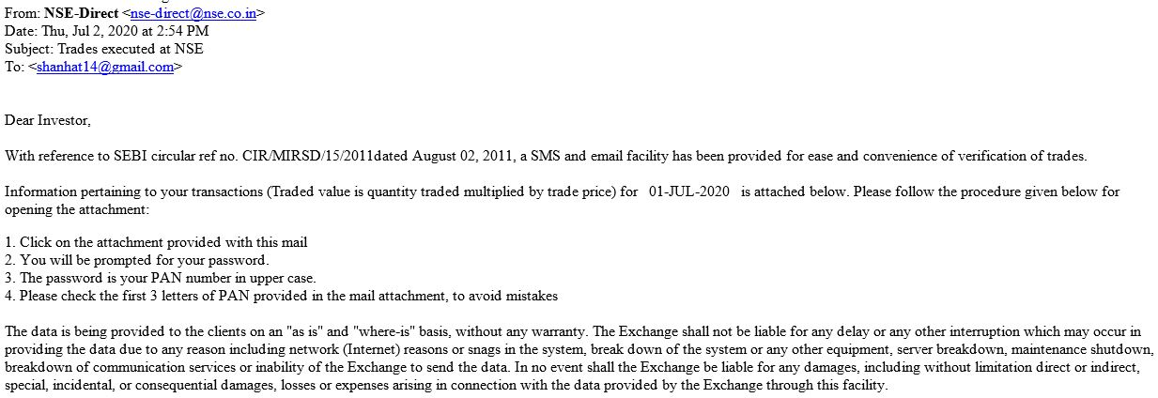
Post Trade: Trade Confirmation
by Stock Exchange
Trade Confirmation by Email
  Contains breakup of trades executed through a TM on a day
  Email will come from domain of Stock Exchange
Source : https://www.nseindia.com/
29

Slide 30
Post Trade: Trade check / verification
on Stock Exchange Website (1/4)
Trade verification facility available on the Exchange Website
  The data on trades would be available on T+1 day.
  At any given point in time 10 trading days' data would be available for verification.
  Please ensure to provide / update latest email address and mobile number to trading members.
  Review with trading members the status of upload of email address and mobile numbers on the Stock Exchange’s Online System to ensure receipt of trade alerts.
30

Slide 31
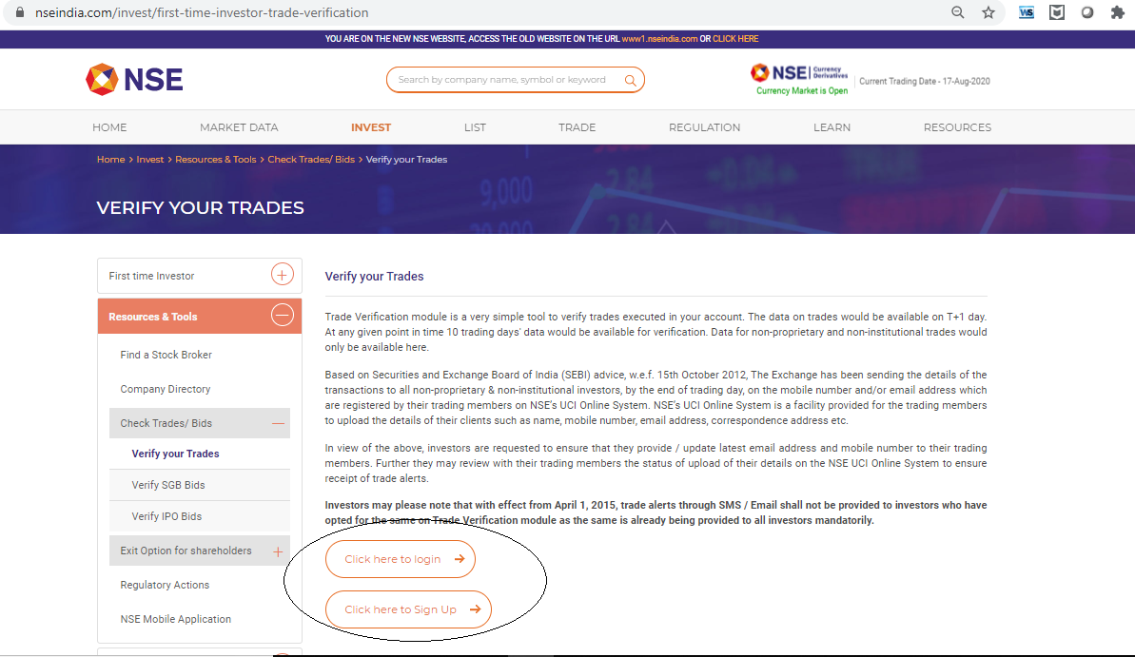
Post Trade: Trade check / verification
on Stock Exchange Website (2/4)
Source : https://www.nseindia.com/
31

Slide 32
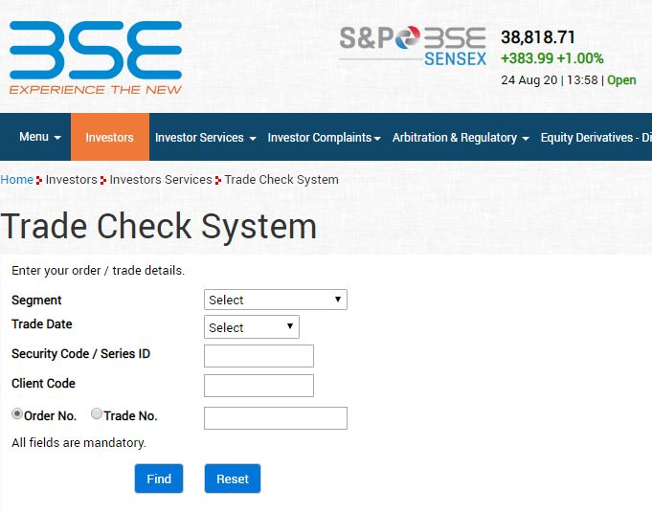
Post Trade: Trade check / verification
on Stock Exchange Website (3/4)
Source : https://www.bseindia.com/
32

Slide 33
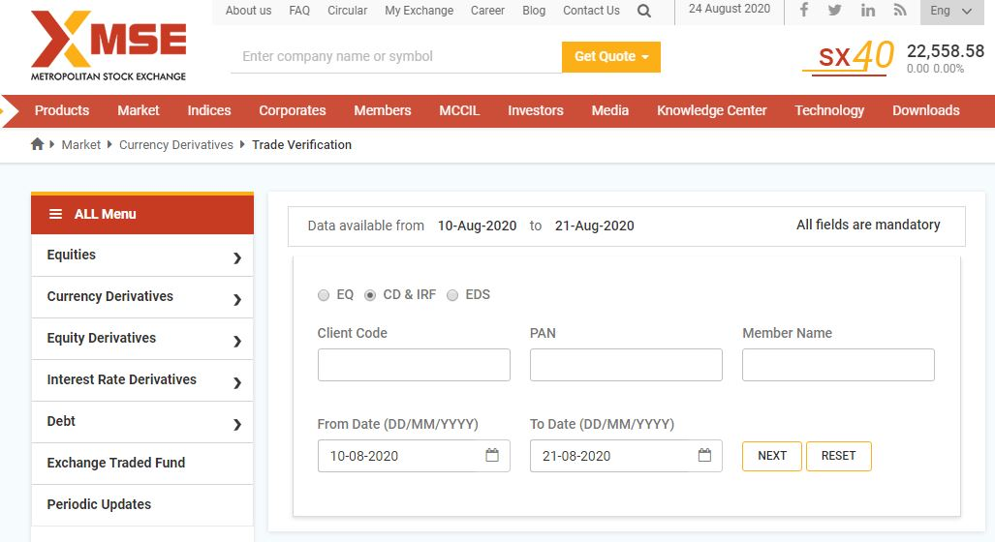
Post Trade: Trade check / verification
on Stock Exchange Website (4/4)
Source : https://www.msei.in/
33

Slide 34
Post Trade: Contract Note
What is a Contract note?
Record of any transaction.
How to receive a Contract Note?
Within 24 hours from the date of trade execution.
Confirmation of trade done.
In case of discrepancy, contact your broker immediately.
What does a Contract Note contain?
Details of transaction.
Date, Time, Price, Quantity, Trade ID, various charges/ levies, etc.
E-Contract Note sent to registered email ID.
Can opt for Physical Contract Note.
Quarterly statement of funds and securities .
34

Slide 35
Post Trade: What should a Contract Note Contain?
Basic details:
Details for each trade executed (Buy/ Sell):
Any discrepancies observed in the Contract Notes should be brought to the notice of your TM in writing, immediately
Client Code
Client PAN
Trade Date
Order No.
Trade No.
Trade Time
Scrip Code/ ISIN/ Contract Details
Traded Price
Trade Quantity
Brokerage & Charges (as per Tarriff Sheet)
Net Rate
Brought forward Position (only in derivatives)
35

Slide 36
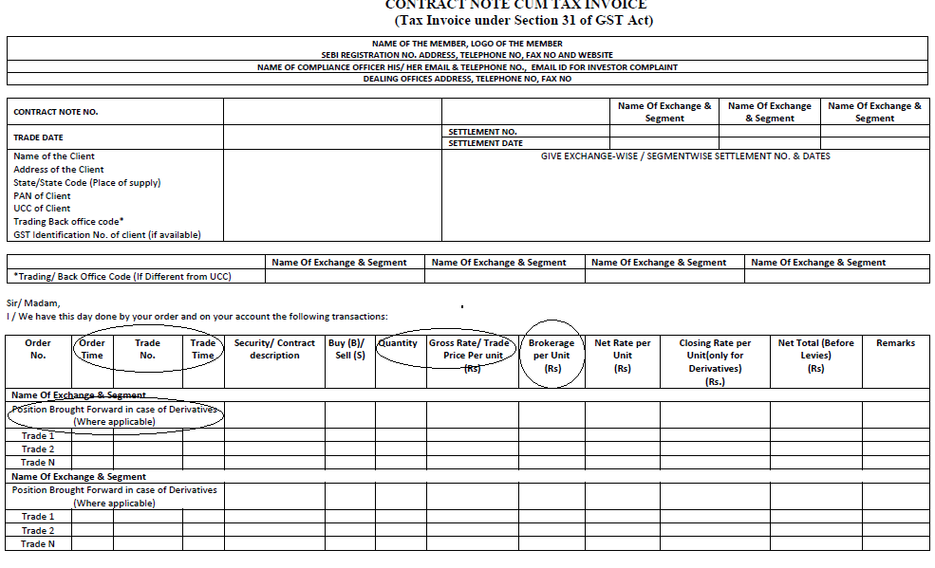
Post Trade: Sample Contract Note (1/2)
36

Slide 37
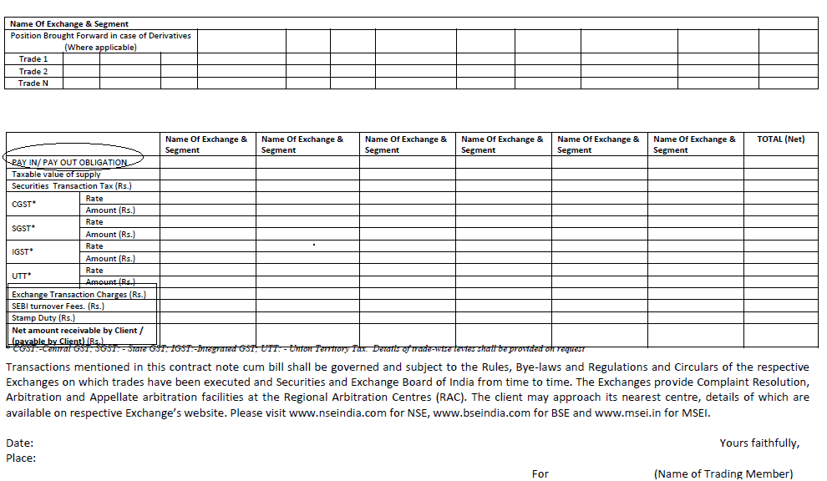
Post Trade: Sample Contract Note (2/2)
37

Slide 38
Post Trade: How to make payment to Stock Broker (Buy Trade)?
PAY-IN OF FUNDS:
- Stocks: Before T+2
- Derivatives: Before T+1
- Only Cheque / NEFT / RTGS to TM
- Transfer from the bank account linked with client code only
- In 3-in-1 Accounts, funds are automatically deducted from linked Bank Account
- Confirmation to be obtained from the TM for receipt of funds
PAY OUT OF SECURITIES:
- Shares should be received in Beneficiary Account of investor within 24 hours of payout.
CASH DEALING IS STRCTLY PROHIBITTED
38

Slide 39
Post Trade: How to make payment to Stock Broker (Sell Trade)?
PAY-OUT OF FUNDS:
- Stocks: On T+2
- Derivatives: On T+1
- Stock Broker to transfer funds to the client (investor) within 24 hours of payout.
PAY-IN OF SECURITIES:
- Investor is advised to confirm the availability of shares prior to executing sale of shares.
- In case POA has not been given, ensure transfer of shares by giving a filled in DIS Slip
39

Slide 40
Post Trade: Default of pay-in obligation and short delivery of shares
Default of Pay- In Obligation and Short Delivery of Shares
Delayed payment Charges: | Levied when investor delays the payment beyond the pay-in time on the settlement day. Levied to discourage delayed payment from investors.
Auction of securities in case of default: | When investor does not deliver securities by pay-in time on the settlement day. For all such “short deliveries”, Clearing Corporation conducts a “buying-in auction” on the settlement day (T+2), after completion of the pay-out, through the exchange trading system.
40

Slide 41
Post Trade: Settlement Process & Running A/C
Settlement of Funds:
Pay-Out happens on T+2 Basis.
Settlement of funds and / or securities to be done within one working day of the pay-out (unless it is a “Running Account”).
Running Account Authorization :
Authorize by Client to the Broker (in writing) to maintain a running account.
Funds and securities maintained on a running account basis have to be settled by Broker on a monthly / quarterly basis, as per the client mandate.
Broker has to ensure that there is a gap of maximum 30/ 90 days (as per the client mandate) between two running account settlements.
41

Slide 42
Post Trade: Checking Credit of Shares
(Delivery Trades)
Credit of shares happens on T+2 day
Shares debited from Seller Client A/C: Around 11 AM.
Subsequently shares come to Pool A/C of Broker
Broker credit these shares to Account of Buyer by EOD.
Investor should insist that shares be transferred to his own Demat A/C and avoid leaving shares in Stock Broker’s Pool Account.
On T+3 day, client should check his Demat A/C for the receipt of shares
Check your Demat statement on Depository website :
  NSDL – NSDL IDeAS Speed-e: https://eservices.nsdl.com/
  CDSL– CDSL Easi: https://www.cdslindia.com/Footer/Easi.html
42

Slide 43
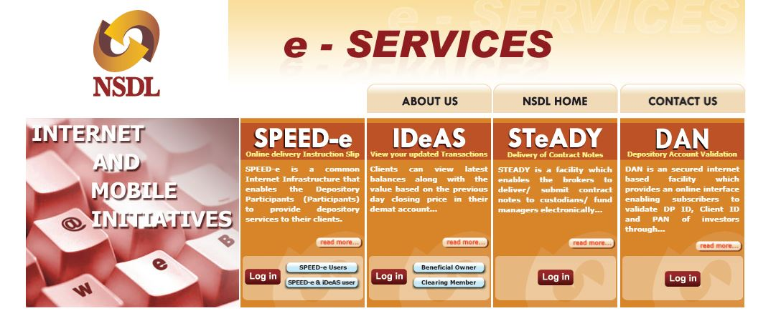
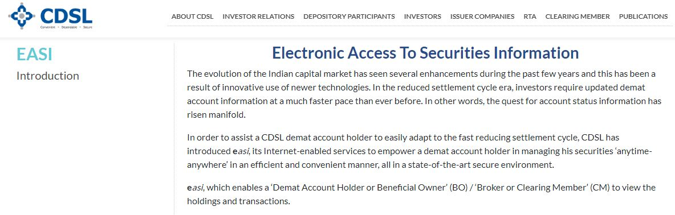
Post Trade: Checking Credit of Shares
(Delivery Trades)
Check your Demat statement on Depository website:
  NSDL – NSDL : IDeAS
  https://eservices.nsdl.com/
  CDSL– CDSL : Easi
  https://www.cdslindia.com/Footer/Easi.html
43

Slide 44
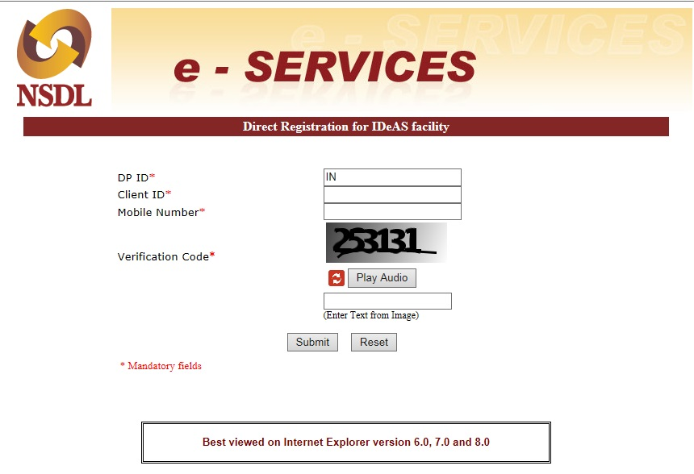
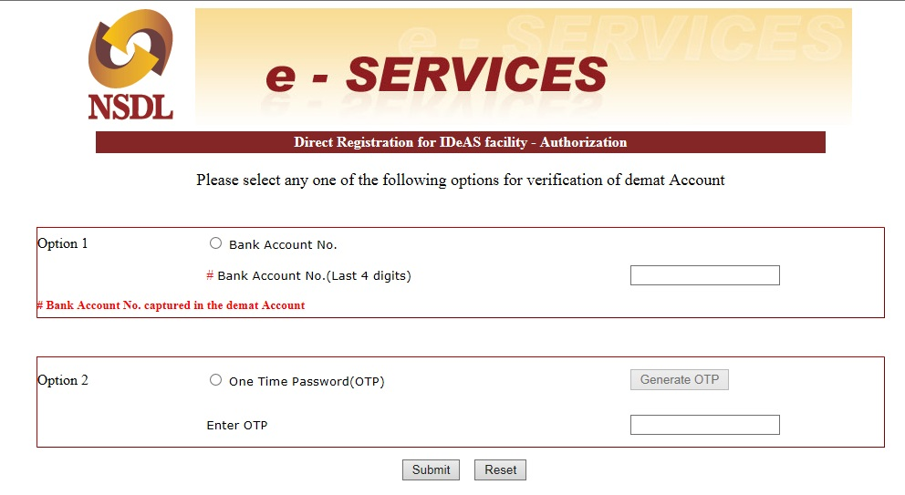
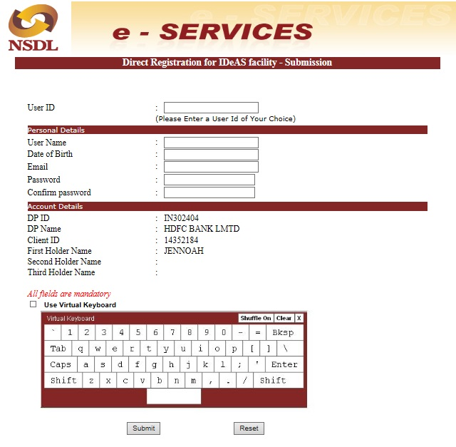
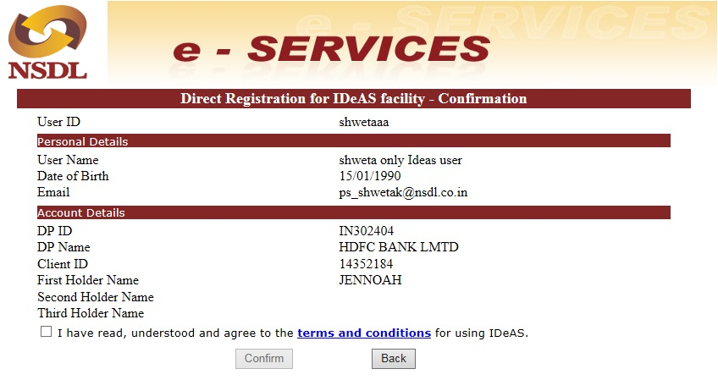
IDeAS : Registration Process (1/2)
Step 1
Step 2
Step 3
Step 4
44

Slide 45
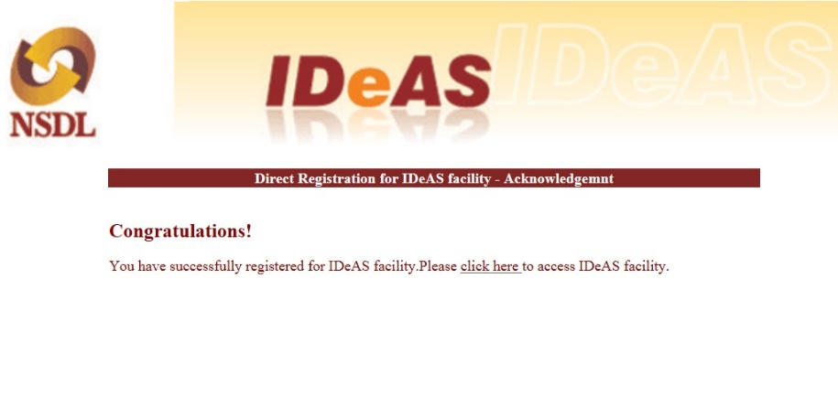
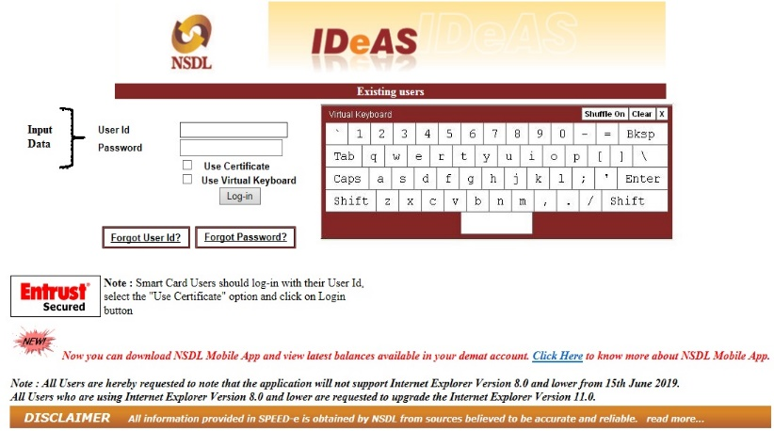
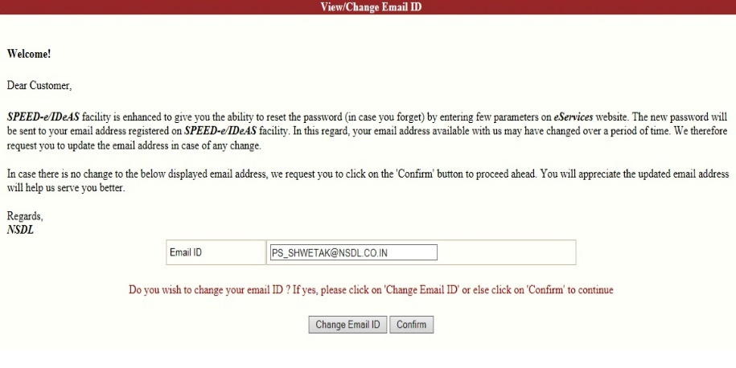
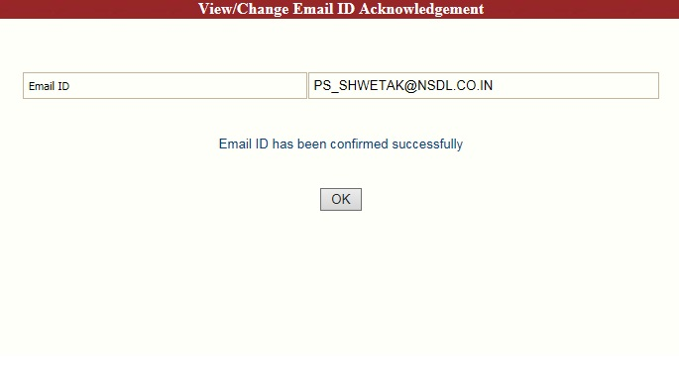
IDeAS : Registration Process (2/2)
Step 6
Step 5
Step 7
Step 8
45

Slide 46
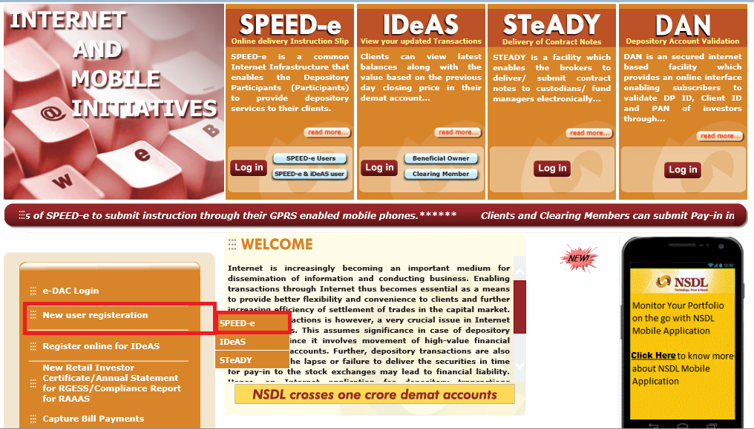
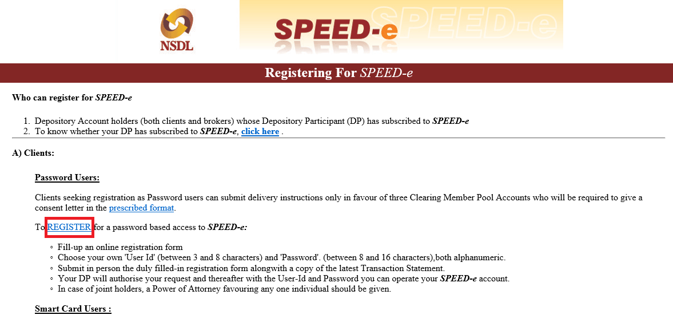
SPEED-e: Registration Process (1/4)
46

Slide 47
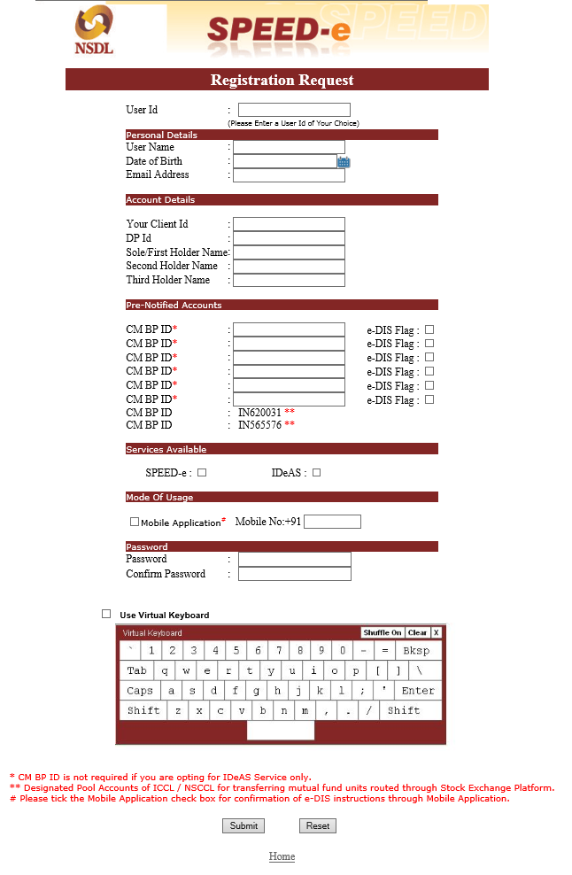
SPEED-e: Registration Process (2/4)
47

Slide 48
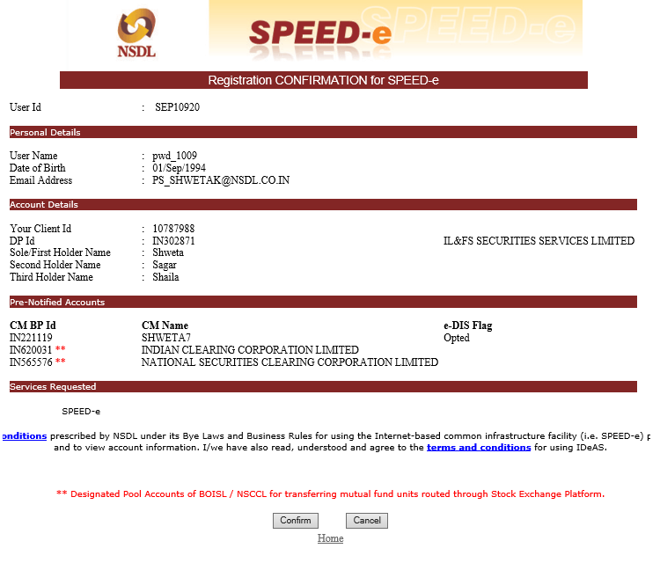
SPEED-e: Registration Process (3/4)
48

Slide 49
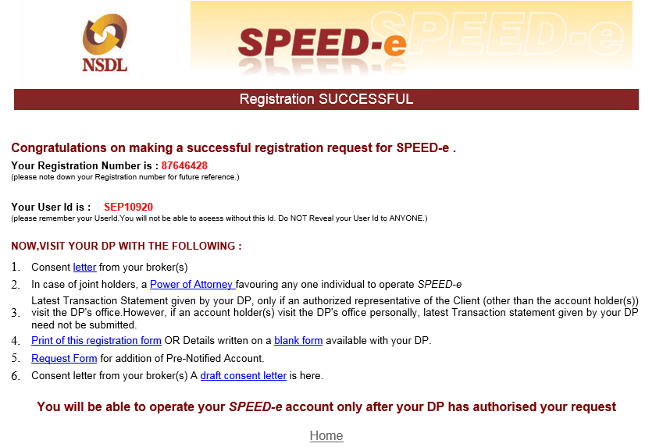
SPEED-e: Registration Process (4/4)
49

Slide 50
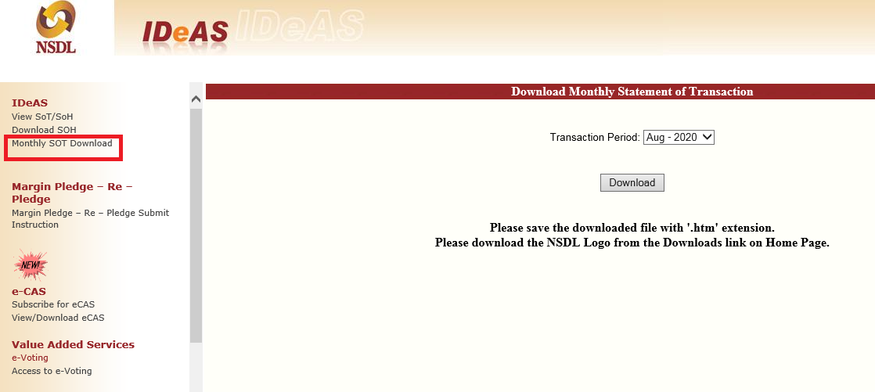
SPEED-e:
Downloading Statement of Transactions
50

Slide 51
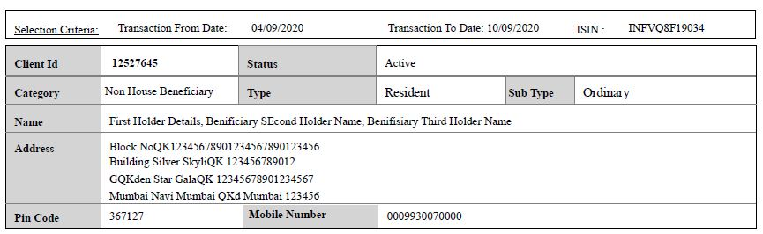
SPEED-e:
Sample Statement of Transactions
51

Slide 52
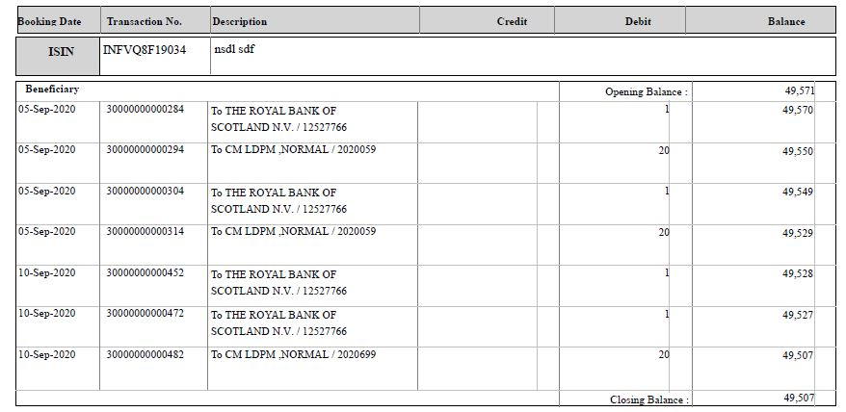
SPEED-e:
Sample Statement of Transactions
To a specific entity (individual / company, etc.)
To Clearing Member (usually the Stock Broker) for pool account
52

Slide 53
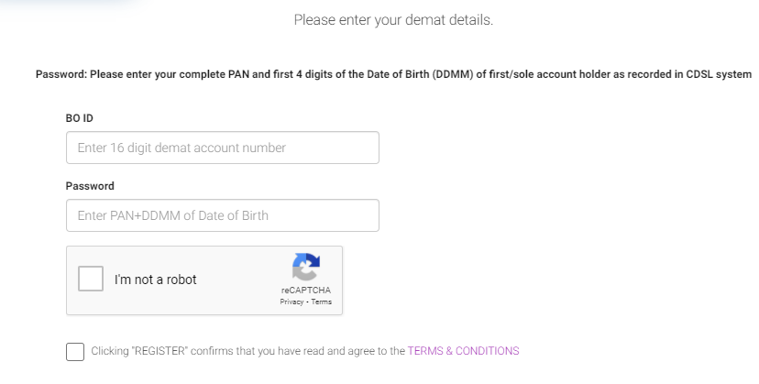
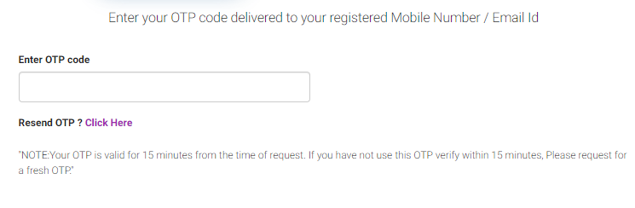
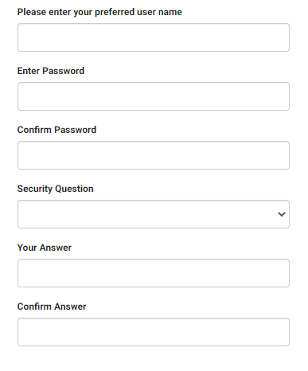
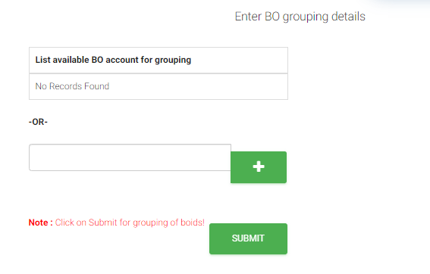
Easi : Registration Process (1/2)
Step 1
Step 2
Step 3
Step 4
44

Slide 54
Post Trade: Delivery Instruction Slip
What is a Delivery Instruction Slip (DIS)?
Like a “Cheque Book” for a DEMAT Account.
Purpose
Used by the DP to debit the client account for the said number of shares.
Types of DIS
Intra Depository (CDSL to CDSL or NSDL to NSDL).
Issued by DP when you open a Demat A/C.
Client needs to fill, sign and submit the DIS to transfer shares.
Inter Depository (CDSL to NSDL or vice versa).
53

Slide 55
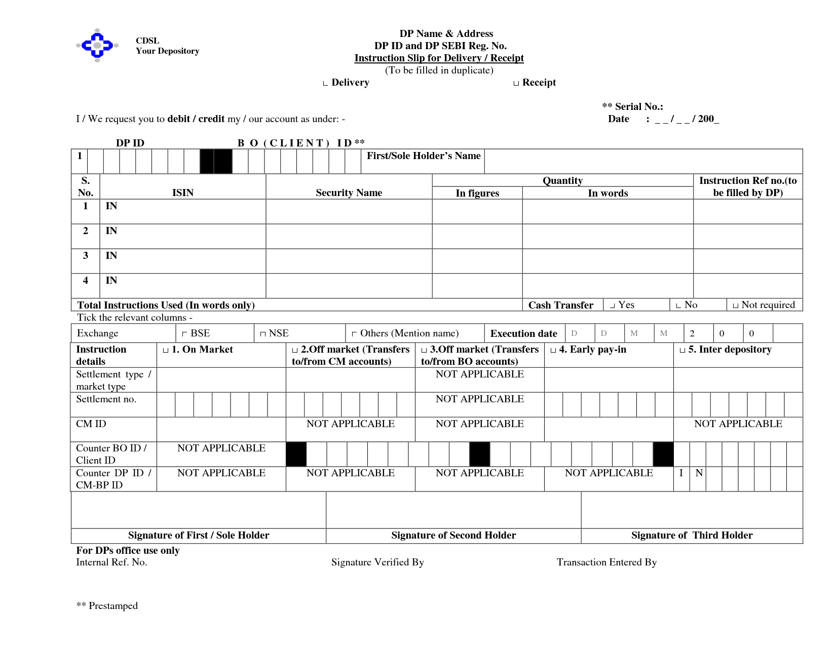
Post Trade: Sample DIS - CDSL
54

Slide 56
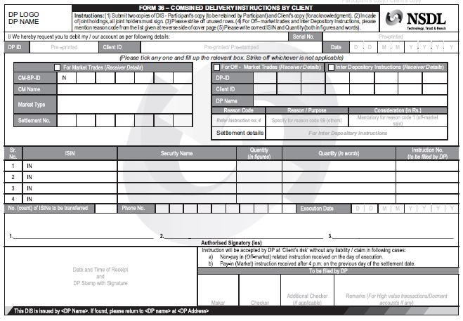
Post Trade: Sample DIS - NSDL
55

Slide 57
Post Trade: Information to be filled in DIS
INFORMATION | DETAILS
Client ID | Client ID given by the DP (8 digit / 16 digit).
Client Name | Fill your name (same as in the Demat A/C).
Date | Date of submitting the DIS.
ISIN number | ISIN of security to be transferred.
Security Name | Name of the security to be transferred.
Quantity in figures | No. of securities (in figures).
Quantity in words | No. of securities (in words).
Total instruction Issued | Total number of ISINs. (Number of scrips in which dealt).
Consideration amount | Value of securities on date of transfer.
Reason for Transfer | Select from the given options.
56

Slide 58
Post Trade: Information to be filled in DIS
INFORMATION | DETAILS
Execution date (Optional) | Specify the date on which the instructions are to be executed.
A/C Transfer within CDSL - BO-BO | Transfer to another Individual's CDSL DEMAT account.
A/C Transfer within CDSL - BO-CM / CM-BO / CM-CM | Transfer to a Clearing Member/Broker's CDSL account.
Inter Depository - BO-BO | Transfer to another Individual's NSDL DEMAT account.
Inter Depository - BO-CM / CM-BO / CM-CM: | If you are transferring to a Clearing Member/Broker's NSDL account.
Counter BO name | Name of person to whom securities are being transferred.
Signature of the 1st / 2nd / 3rd holder – | Signature must match with the specimen signature given to the DP when opening the DP Account.
57

Slide 59
Post Trade: Do's and Don'ts of keeping funds in Trading Account
Do’s:
Investor should make sure funds to the extent of obligation (Pay-in & Margin) is available in your trading account.
Investor should transfer funds to the Stock broker for obligation only.
Ensure all the documents are received in the name of the Stock broker only.
Investor should ask Stock broker for Quarterly / Monthly settlement of both funds and securities from the TM.
Check you ledger account periodically.
In case of any suspicious entries kindly raise the alert to Stock Broker / Exchange / SEBI immediately.
58

Slide 60
Post Trade: Do's and Don'ts of keeping funds in Trading Account
Don’ts:
Investors are advised not to keep idle funds lying with the Stock Broker.
Investors are advised not to provide cheques in the name of any “Authorized Person ” / 3rd party.
Pre-Signed Blank Cheques and DIS Slips should NOT be provided to the Stock Broker/ Authorized Person / Employee of the Stock Broker.
59

Slide 61
Margin Payment and Pledge/ Re-Pledge
60

Slide 62
Pre Trade : Payment of Margins
On buying a Stock, investor may
Pay Entire price upfront
Buy it on margin or pay only a % of its price (called margin)
Payment Of Margin:
Check your margin requirement on Stock Broker’s website while placing the trade.
Pay the margin amount to the Stock broker / maintain the margin amount in the linked Bank A/C before placing order.
You may also pledge securities instead of depositing cash as margin money. This can be done by submitting a pledge instruction by filling up the pledge form with the Depository.
61

Slide 63
Pre Trade : Payment of Margins
(Early Pay-in)
Payment of funds / deliver shares (in case of buy/sell) to the Exchange by pay-in time on settlement date.
Early Pay-In: Choice of paying funds / delivering shares before this designated time.
Exemption upon early pay-in of Funds:
No margin needs to be paid (subject to bank confirmation).
Exemption upon early pay-in of securities :
No margin needs to be paid.
Stock Brokers to provide early pay-in details to the Stock Exchange in a specified format.
62

Slide 64
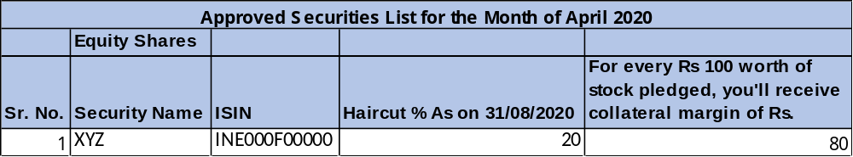
Pre Trade : Payment of Margins
(Haircut)
Haircut:
%age by which market value of your pledged shares is reduced for the purpose of calculating the collateral value.
Eg: Market value of your pledged shares = Rs. 10 lac
Haircut = 20%
Collateral value = Rs. 8 lac. {10-(0.20*10)}
Sample:
63

Slide 65
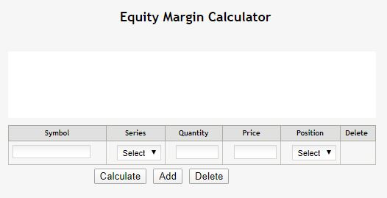
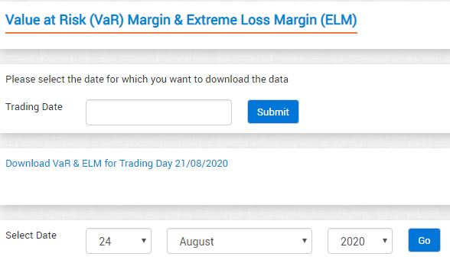
Pre Trade : Payment of Margins
NSE margin Calculator :
https://www1.nseindia.com/live_market/dynaContent/live_watch/margincalc/CMInputMargincalc.jsp
BSE margin Calculator:
https://www.bseindia.com/markets/equity/EQReports/margin.aspx
64

Slide 66
What is a Pledge? : Simplified
PLEDGE: Deposit of some personal property as collateral for a Debt.
To borrow some funds to pay margin, you can pledge the securities (viz. shares, bonds, etc.) owned by you in order to get these funds.
Pledged securities act as collateral for this loan.
If borrower of funds (pledger) defaults on repayment, the person to whom the shares are pledged (pledgee) can invoke the pledge (i.e. sell these securities to recover his money).
Provisionally movement of securities from the pledger's/ debtor’s securities account into the pledgee’s/ creditor’s securities account to back a debt facility as a form of collateral.
When securities are pledged, the pledgee/creditor only has possession of the pledged securities but not ownership or title to the pledged securities.
65

Slide 67
What is a Pledge? : Simplified
Pledger borrows funds from Pledgee
Deposits Shares as Collateral for funds borrowed.
PLEDGER
PLEDGE
PLEDGEE
Pledgee lends funds to Pledger
Accepts Shares as Collateral for the funds lent.
66

Slide 68
Margin Pledge : Previous Process
Investor wants to Pledge his stocks to obtain margins.
Securities transferred from investor’s demat account to Stock Broker’s Demat Account
- Through Title transfer collateral arrangements or Power of Attorney in respect of client’s demat account
Stock Broker pledges these securities to Clearing Corporation.
Transfer of ownership of the securities (called “Title” in legal language) takes place and this is called the “Transfer of Title” method.
This method is prone of misuse by Stock Brokers since there is a transfer of ownership and the entire cycle is based solely on trust.
67

Slide 69
Margin Pledge : The new way
Stocks stay in the investor’s Demat account.
No change of ownership of stocks happens.
Investor makes a pledge in favor of the Stock Broker.
Stock broker is required to open a separate demat account labelled ‘TMCM – Client Securities Margin Pledge Account’ for this purpose (TMCM = Trading Member Clearing Member).
The broker then re-pledges these securities in favour of the Clearing Corporation and obtains margins.
68

Slide 70
Margin Pledge in Depository System : Explained
Effective from September 01, 2020.
Investors can now provide margin in form of “Securities”.
- By pledging securities in favour of specially designated demat account of Stock Broker.
What’s New?:
  Stock Brokers can accept securities (viz. shares) as collateral only in form of margin pledge created on the securities held in client’s Demat account.
69

Slide 71
Margin Pledge in Depository System : Explained
What does the Investor need to do?:
  Give instruction to create margin pledge on securities.
  Instruction may be given in:
  Physical form
  Electronically through “SPEED-e” (for NSDL) and “Easi/Easiest” (for CDSL).
Pledged to whom?
  Created in favor of a “specially designated” demat account of the stock broker/ clearing member.
  Name of the account :
  TM – Client Securities Margin Pledge Account or TM / CM – Client Securities Margin Pledge Account).
70

Slide 72
What is a “Re-Pledge”?
“Re-pledge” of securities by Stock Broker, that it received as “pledge” from investor, in favour of Clearing Member (CM).
CM can “re-pledge” the same securities in favour of Clearing Corporation (CC) in respect of approved securities.
Stock Brokers who are trading as well as Clearing members may directly pledge securities to CC.
Investor need to give consent for Re-pledge (given initially when investor pledged shares with Stock Broker) for underlying securities.
Details of all pledge transactions and subsequent re-pledge transactions shall be displayed in the client’s demat account statement.
List of all clearing corporations :
  https://www.sebi.gov.in/clearing-corporations.html
71

Slide 73
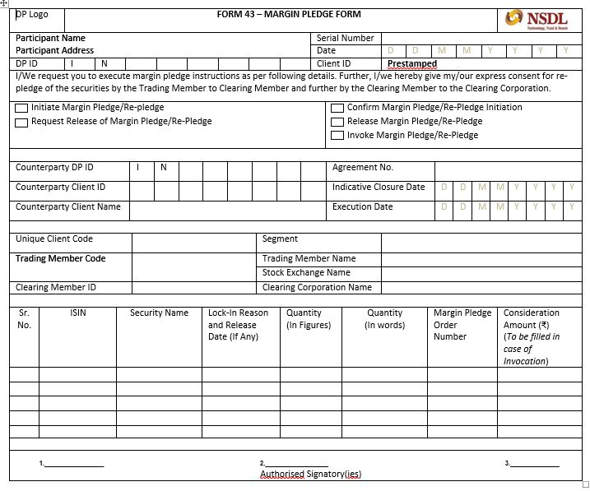
Sample Margin Pledge Form
72

Slide 74
Margin Pledge Creation by Investor
On receipt of margin pledge instruction, depository shall send a link to ‘Confirm Margin Pledge Transaction’ through SMS and email to Investor.
Receive Confirmation Link
Click the Link
Authenticate with PAN
Confirm Pledge
Receive OTP
Investor must verify the information displayed and if satisfied, confirm the instruction to create pledge with the OTP received.
Investor needs to Click the link received – which will lead to a web page of Depository.
After successful PAN authentication, One Time Password (OTP) will be sent to Investor through SMS and email.
Client should authenticate the instruction with PAN.
73
Notes:
© Copyright PresentationGo.com – The free PowerPoint template library

Slide 75
Margin Pledge Closure by Investor
Client can submit instruction for Closure of Margin Pledge existing in his / her demat account in physical form or electronically through SPEED-e / IDeAS facility
Submit Closure Instruction
Confimation by Pledgee
Instruction by Broker
Alternatively, stock broker can give an instruction for unilateral closure of the pledge
Pledge will be closed when it is confirmed by the concerned stock broker (pledgee TM)
If the securities have been re-pledged by TM in favour of CM (or by CM in favour of CC), then margin pledge closure will need to be confirmed by concerned CM (or by CC). Alternatively, CM or CC may give an instruction for unilateral closure of the re-pledge.
74
Notes:
© Copyright PresentationGo.com – The free PowerPoint template library

Slide 76




Invocation of Margin Pledge / Re-pledge
Tm Submits instruction
Securities debit
If re-pledged by tm
validation
If the client defaults in payment, then:
Stock Broker (TM) can submit instruction for Invocation of Pledge existing in its favour.
This instruction can be sent in physical form or electronically through electronic facility of the depository.
Upon successful execution of Pledge Invocation instruction in Depository system, securities will be debited from the client’s demat account (Pledgor’s account) and credited to TM’s demat account (Pledgee’s account).
If the securities have been re-pledged by Stock Broker in favour of Clearing Member (and then to Clearing Corporation), then Invocation initiated by TM will be effective when pledge is released by the concerned CM (and by concerned CC).
Validation of the margin pledge instruction will be done with the UCC linked in the demat account of the Client.
If there is default by TM / CM then the re-pledged securities of clients who do not have any open position with CM / CC, shall not be available to CM / CC for invocation to meet settlement default of the TM / CM.
75
Notes:
© Copyright PresentationGO.com – The free PowerPoint and Google Slides template library

Slide 77
Thank You
76

